Slide 1
Research Mid-Term Report Faster Sorting Algorithm by Employing Fundamentals of Statistics
January 19, 2018
Soumya Mishra https://github.com/SoumyaMishra8/Mishra-AOS_JR_SortAlg

Slide 2
WHY ARE SORTING ALGORITHMS IMPORTANT?
25% - 50% of what computers do require sorting
Efficiency, speed, processing data
Search Engines (sort through website to find relevant one)
Graphical processes (layering is necessary)
Government organizations, financial institutions, commercial enterprises (transactions, accounts)

Slide 3
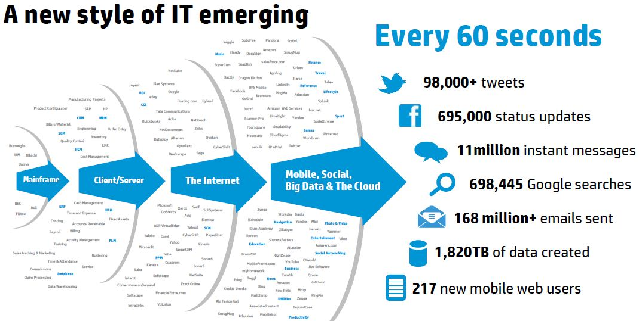
WHAT IS BIG DATA?
Collected by the Government, NASA, Research Institutions
Data sets are so large and complex
IT systems have trouble processing data
Volume, veracity, variety, and velocity
Challenge of indexing, searching, transferring data
https://onlinembapage.com/data-analytics-mba/

Slide 4
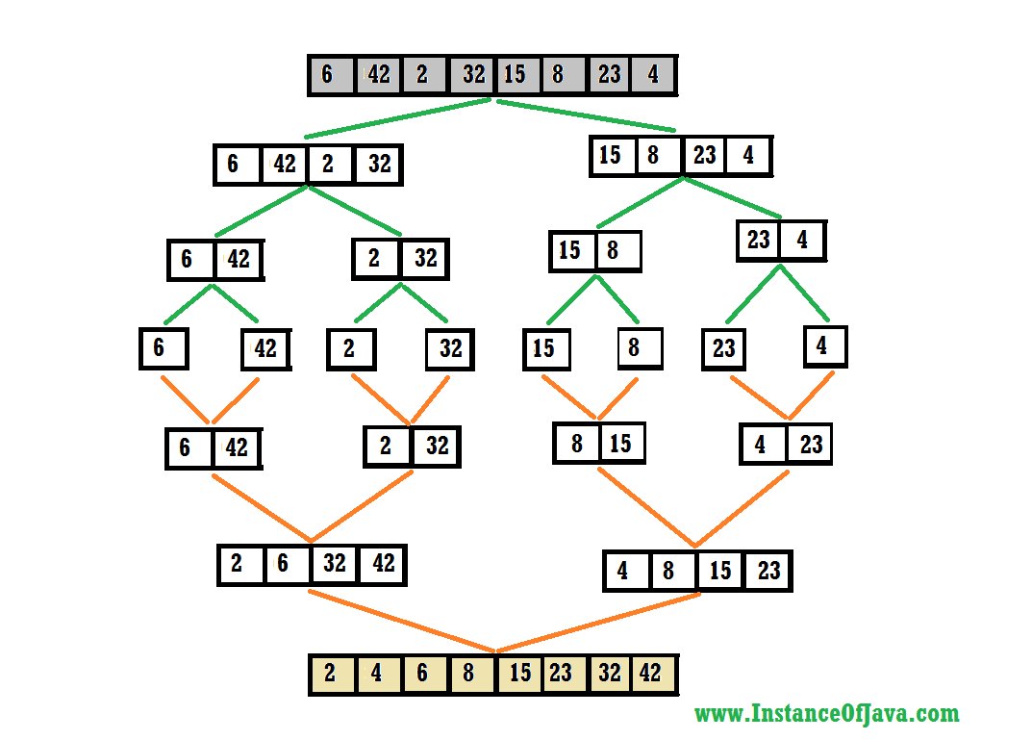
SORTING BIG DATA - Merge Sort
Cases:
Best case: O(n log(n))
worst case: O(n log(n))
average case: O(n log(n))
Issues:
comparison-based = too many passes
each array = own space in memory
http://www.instanceofjava.com/2016/08/merge-sort-algorithm-in-java-example.html

Slide 5
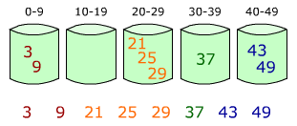
SORTING BIG DATA - Bucket Sort
Cases:
Best case: O(n+k)
worst case: O(n²)
average case: O(n²)
Issues:
wastes memory
does not work well for data that follows certain types of distributions https://www.quora.com/What-is-a-simple-explanation-of-bucket-sort

Slide 6
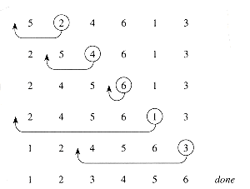
SORTING BIG DATA - Insertion Sort
Cases:
Best case: O(n)
worst case: O(n²)
average case: O(n²)
Issues: https://www.ee.ryerson.ca/~courses/coe428/sorting/insertionsort.html
comparison-based = reliant on passes
uses up a lot of memory

Slide 7
WHY DO WE NEED NEW SORTING ALGORITHMS?
CURRENT SORTING ALGORITHMS REQUIRE TOO MUCH MEMORY, TOO MANY PASSES AND TOO MUCH TIME
Implement neural networks
Using more servers, linked lists, multiple parallel processors
Different ways of distributing data amongst servers
Implementing both GPUs and CPUs

Slide 8
A BETTER AND FASTER WAY TO SORT
reduce compute time and ram requirements
use statistical analysis to determine bucket ranges based on data set
<1000 elements in each bucket (number of elements are equal)
should be able to sort data sets that follow any type of distribution
worst case of o(n)

Slide 9
A VISUAL REPRESENTATION
µ = 5.5
Median = 5.5
SD = 2.88
5 9 8 1 4 6
Bucket 1
Bucket 2
Bucket 3
-2δ to –.5δ
-.18δ to 0δ
0.1δ to 1δ
1 4 5 6 8 9
1 4
5 6
9 8

Slide 10
VARIABLES, CONSTANTS, CONTROLS
Independent variable – using statistical analysis to set the parameters of the bucket
Dependent variable – time complexity using Big-O notation; time it takes for algorithm to sort n elements
Constants
Memory available
Laptop and processor
Bucket sort

Slide 11

VARIABLES, CONSTANTS, CONTROLS
Constants (continued)
Merge sort
Array.parallelSort
Multiple processing units (6 node network)
Control – run time for bucket sort and merge sort for the same number of elements that are being tested
https://www.etb-tech.com/dell-poweredge-c6220-1x24-4-x-node-server-8xe5-2680-256gb-4x1300b-lsi-sas-9265-8i.html

Slide 12
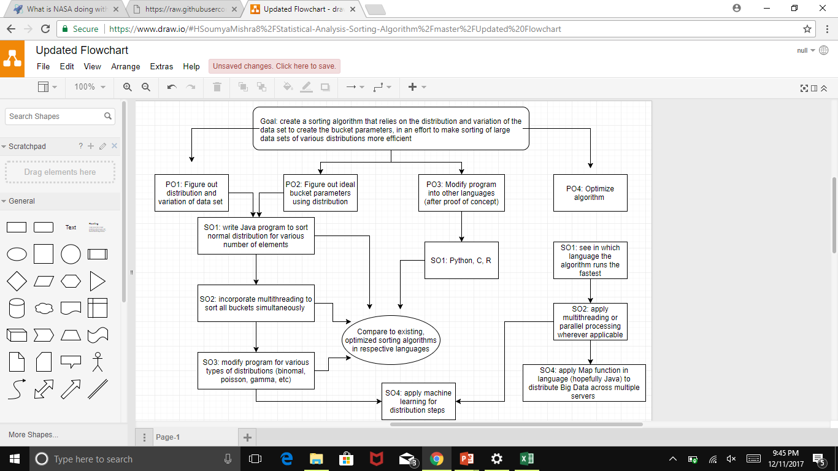

Slide 13
PROJECT STATUS
Programmed “backbone” code in Java
talked to Mr. Kumar about project
Compared runtime of Java code to runtime of Parallel Sort
Programmed code in Python - same code as Java
Compared runtime of Python code to runtime of QuickSort in Python
Tried to fix Python code using NumPy and Pandas - collected data

Slide 14
PROJECT STATUS
6) Started examining how to simplify algorithm to make it applicable to different types of distributions
integration technique
box and whisker plot technique - suggested by Mr. Writer
talked to AOS Alumni about integration technique
7) Currently writing programs in Eclipse using Apache Commons to see how much more efficient integration technique is
8) Plan to write program in Mathematica for box and whisker plot technique (and possibly integration technique as well)

Slide 15
OVERVIEW OF JAVA CODE
Obtain the MIN, MAX, MEAN of the data set by implementing a for loop
Create a 2D array for buckets - each bucket has 1000 elements
Use formula for z-score to determine position of bucket index along a range
When a bucket reached 1000 elements, data point would be sent over to next bucket
Merge sort is used to sort each bucket
Arrays are concatenated and then given to user

Slide 16
OVERVIEW OF JAVA CODE
Worked well for the normally distributed data fed into the program
performance will deteriorate with different distributions
efficiency keeps decreasing (from being 98% more efficient to being 47% more efficient as number of data elements increase)
there must be some underlying problem within the code that increases the run time - for loops?

Slide 17
DATA CONTINUED – WHY IS IT SLOWER THAN JAVA?
COLLECTED DATA
Effect of Setting Bucket Parameters on Run Time
Elements | New Sort (s) | Merge Sort (s) | Parallel Sort (s) | Bucket Sort (s)
1000 | 0.01 | 0.22 | 0.26 | 0.19
10,000 | 0.01 | 0.36 | 0.35 | 0.42
100,000 | 0.07 | 0.47 | 0.26 | 0.52
1000,000 | 0.15 | 1.18 | 0.61 | 0.74
10,000,000 | 0.42 | 5.6 | 0.99 | 1.34
100,000,000 | 3.26 | 10.31 | 5.81 | 4.65
1,000,000,000 | HEAP ERROR

Slide 18
OVERVIEW OF PYTHON CODE
Similar to Java code in the method and the way to calculate bucket index
Being compared to Insertion Sort - default Python sorting algorithm
Does not work as expected because of execution delays in Python itself
The two for loops are causing run times to increases substantially

Slide 19
DATA COLLECTED (IT DOES NOT WORK)
COLLECTED DATA
Comparing run times of Insertion Sort and New Sort
Elements | Python Sort |  |  | New Sort
 | Start Time (s) | End Time (s) | Total Time (s) | Start Time (s) | End Time (s) | Total Time (s)
1000 | 16.29 | 16.32 | 0.03 | 27.11 | 27.18 | 0.06
10,000 | 13.76 | 13.82 | 0.06 | 24.13 | 24.25 | 0.12
100,000 | 38.08 | 38.26 | 0.18 | 10.49 | 11.30 | 0.81
1,000,000 | 4.98 | 8.52 | 3.54 | 42.36 | 48.70 | 6.34
10,000,000 | 8.01 | 48.71 | 40.69 | 47.59 | 104.15 | 56.57

Slide 20
MORE DATA
COLLECTED DATA
Comparing run times of Insertion Sort and New Sort
Elements | Python Sort |  |  | New Sort - with NumPy Array
 | Start Time (s) | End Time (s) | Total Time (s) | Start Time (s) | End Time (s) | Total Time (s)
1000 | 57.98 | 57.98 | 0.00 | 4.02 | 4.02 | 0.00
10,000 | 4.13 | 4.14 | 0.02 | 48.44 | 48.58 | 0.14
100,000 | 25.69 | 25.78 | 0.10 | 13.70 | 14.93 | 1.23
1,000,000 | 15.06 | 18.03 | 2.98 | 0.59 | 15.80 | 16.40
Run time has significantly decreased from before
Can time still be cut using numpy array for the 2D list as well?

Slide 21
MORE DATA
COLLECTED DATA
Python - Sort with Complete NumPy (Sort, Arrays)
Elements | Time for NumPy Array (s) | Time for Stat Collection (s) | Time for Bucketing (s) | Total Time (s) | Sort
1000 | 0 | 0.000 | 0.023 | 0.023 | 0.000
10,000 | 0 | 0.000 | 0.157 | 0.162 | 0.005
100,000 | 0.031 | 0.000 | 1.661 | 1.926 | 0.265
1,000,000 | 0.267 | 0.013 | 16.530 | 45.109 | 28.580
Time to create numpy array is gradually increasing
Time for stat collection is negligible
Why don’t the run times improve as much as expected?
Insertion Sort

Slide 22
ANOTHER WAY TO APPROACH THE ISSUE
current Java algorithm will work for normally distributed data (proof of concept)
will not work for other types of distributions
need to create a more universal approach
minimize the computations needed to assign number to bucket
minimize the time it takes to collect statistics
need to figure out a way to use correct formula to sort given data based on distribution without wasting too much time

Slide 23
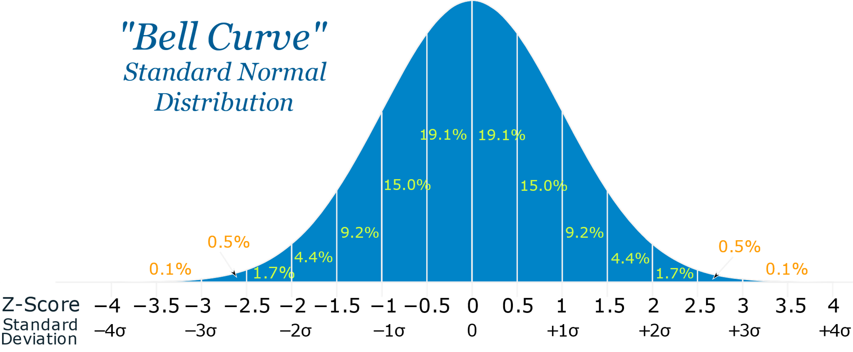
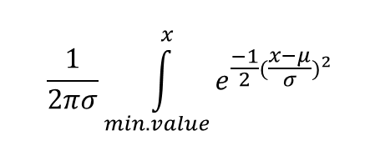
INTEGRATION TECHNIQUE
Key Features
Formula for bucket index
Distribute numbers evenly between buckets
Use area under the curve to determine to determine bucket index
Low resources for sorting each bucket
dx
1
1000/n

Slide 24
LIMITATIONS OF TECHNIQUE
Can be efficient
other types of distributions rely on degrees of freedom and slopes of probability
computation time may increase
if the degrees of freedom and parameters are given, then this could work
there are ways to estimate these parameters using least squares and other methods = too much time
Can implement a new technique using box and whisker plots - suggested by Mr. Writer

Slide 25
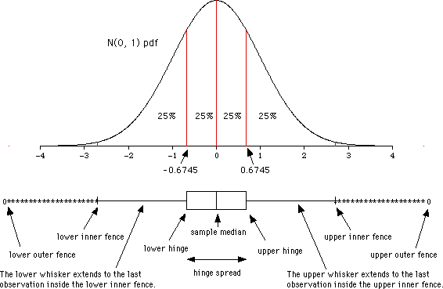
BOX-AND-WHISKER PLOT TECHNIQUE
instead of quartiles
quintiles
deciles
can have each section cover same area (0.01) and then proceed with algorithm
http://ms.mcmaster.ca/peter/s2ma3/s2ma3_9798/boxplots.html

Slide 26
SUMMARY
Java code = 50% more efficient than Parallel Sort, Merge Sort, Bucket Sort
Python code = 50% less efficient than Quick Sort (default Python sorting algorithm)
NumPy arrays did help solve some problems
using Quick Sort = inefficient
To make Java code more universal, and to reduce the number of computations, can implement
integration technique
box-and-whisker plot technique

Slide 27
FUTURE GOALS
Write code for Integration Technique in Eclipse
can write it in Mathematica as well
Write code for Box-and-Whisker Plot Technique in Mathematica
Collect data for both techniques
compare them with Parallel Sort, Merge Sort, Bucket Sort
compare them with each other
Apply multithreading to the bucketing aspect to reduce run time

Slide 28
REFERENCES
REFERENCES
Wang, L., et al. (2012). G-Hadoop: MapReduce across distributed data centers for data-intensive computing. Future Generation Computer Systems. doi:10/1016/j.future.2012.09.00
Monaknov, A. (2016). Composable multi-threading for python libraries.
Goel, N., Laxmi, V., Saxena, A. (2015). Handling multithreading approach using java. International Journal of Computer Science Trends and Technology.3.2.
Hai, H., Guang-hui, J., & Xiao-tian, Z. (2013). A fast numerical approach for Whipple shield ballistic limit analysis. Acta Astronautica. 93. 112-120. Retrieved from http://dx.doi.org/10.1016/j.actaastro.2013.06.014
Dehne, F., & Zaboli, H. (2016). Parallel sorting for GPUs. Emergent Computation. 293 – 302. doi:10.1007/978-3-319-46376-6_12

